Slide 1

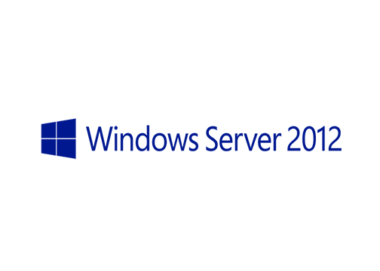
MegaSeries
Install and Configure IPAM

Slide 2
Prerequisites
Have a new server installed and ready for the IPAM server role

Slide 3
Steps
Install the IPAM role
Configure IPAM
IPAM walkthrough and basic management tasks

Slide 4
https://www.youtube.com/channel/UCcZ-jLbPwNr8E_v9-65n8Iw https://github.com/itknowledge4

